Slide 1



GREAT LEARNING WIPRO FSD
Capstone- DO CONNECT

Slide 2
Team Members
Sourabh nalavade
Anubhav verma
Paras tomar
Krishna tangirala
Adarsh kumar verma
Mentor – javeed Muhammad husnuddin sir

Slide 3
introduction
Do Connect is a social is question-and-answer platform that allows users to engage in dialogue with experts in their field. it has become a go-to source for information on a wide range of topics. It is a great resource for learning about new things, finding answers to your questions, and building relationships with other people who share your interests. It's also a great way to stay up-to-date on the latest trends and developments in your field.
To do the above web applications there are two users:-
1. User
2. Admin

Slide 4
objective
Do connect is a popular Question and Answer from in which techniques questions was asked and answered.
So based on this part we have developed a website from which you learn the things by connecting with the other people through online system.

Slide 5
User stories
1. As a user I should be able to login, Logout and Register into the application. 2. As a user I should be able to ask any question under any topic 3. As a user I should be able to Answer any question asked 4. As a user I should be able to answer more than one question and more than one time 5. As a user I should be able to chat with other users. 6. As a user I should be able to upload images to refer

Slide 6
Admin stories
1. As an Admin I should be able to login, Logout into the application. 2. As an Admin I should be able to get mail as soon as any new Question is asked or any Answers given. 3. As an Admin I should be able to approve the question and Answer. 4 Any Question or Answer will be visible on the platform only if it is approved. 5. As an Admin I should be able to delete inappropriate Questions or Answers.

Slide 7
Technologies used
Frontend –
AngularJS
Material UI (Sweetaleat2, MatCard, MatTable etc.)
HTML,CSS
Bootstrap Grid
Backend –
Java
Spring Boot
Data JPA
Microservices
Database –
Mysql

Slide 8
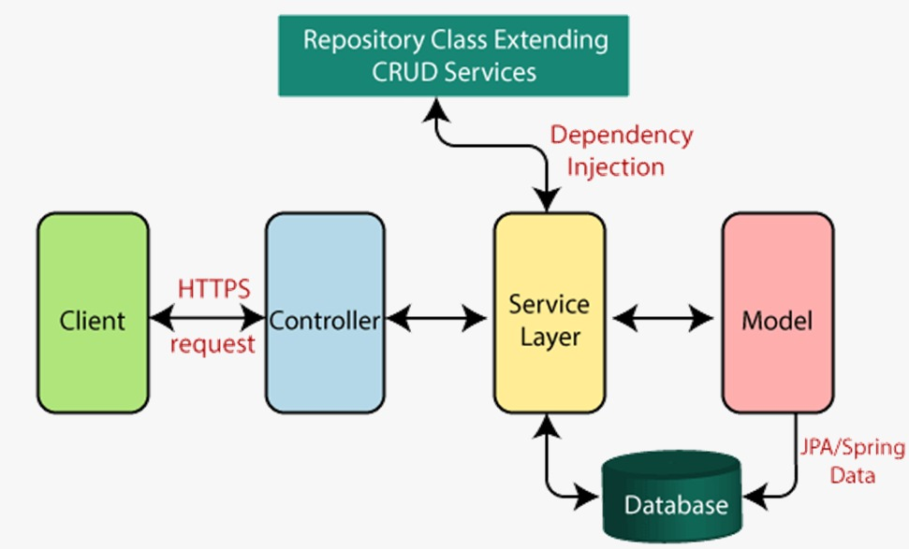
Mvc - architecture

Slide 9
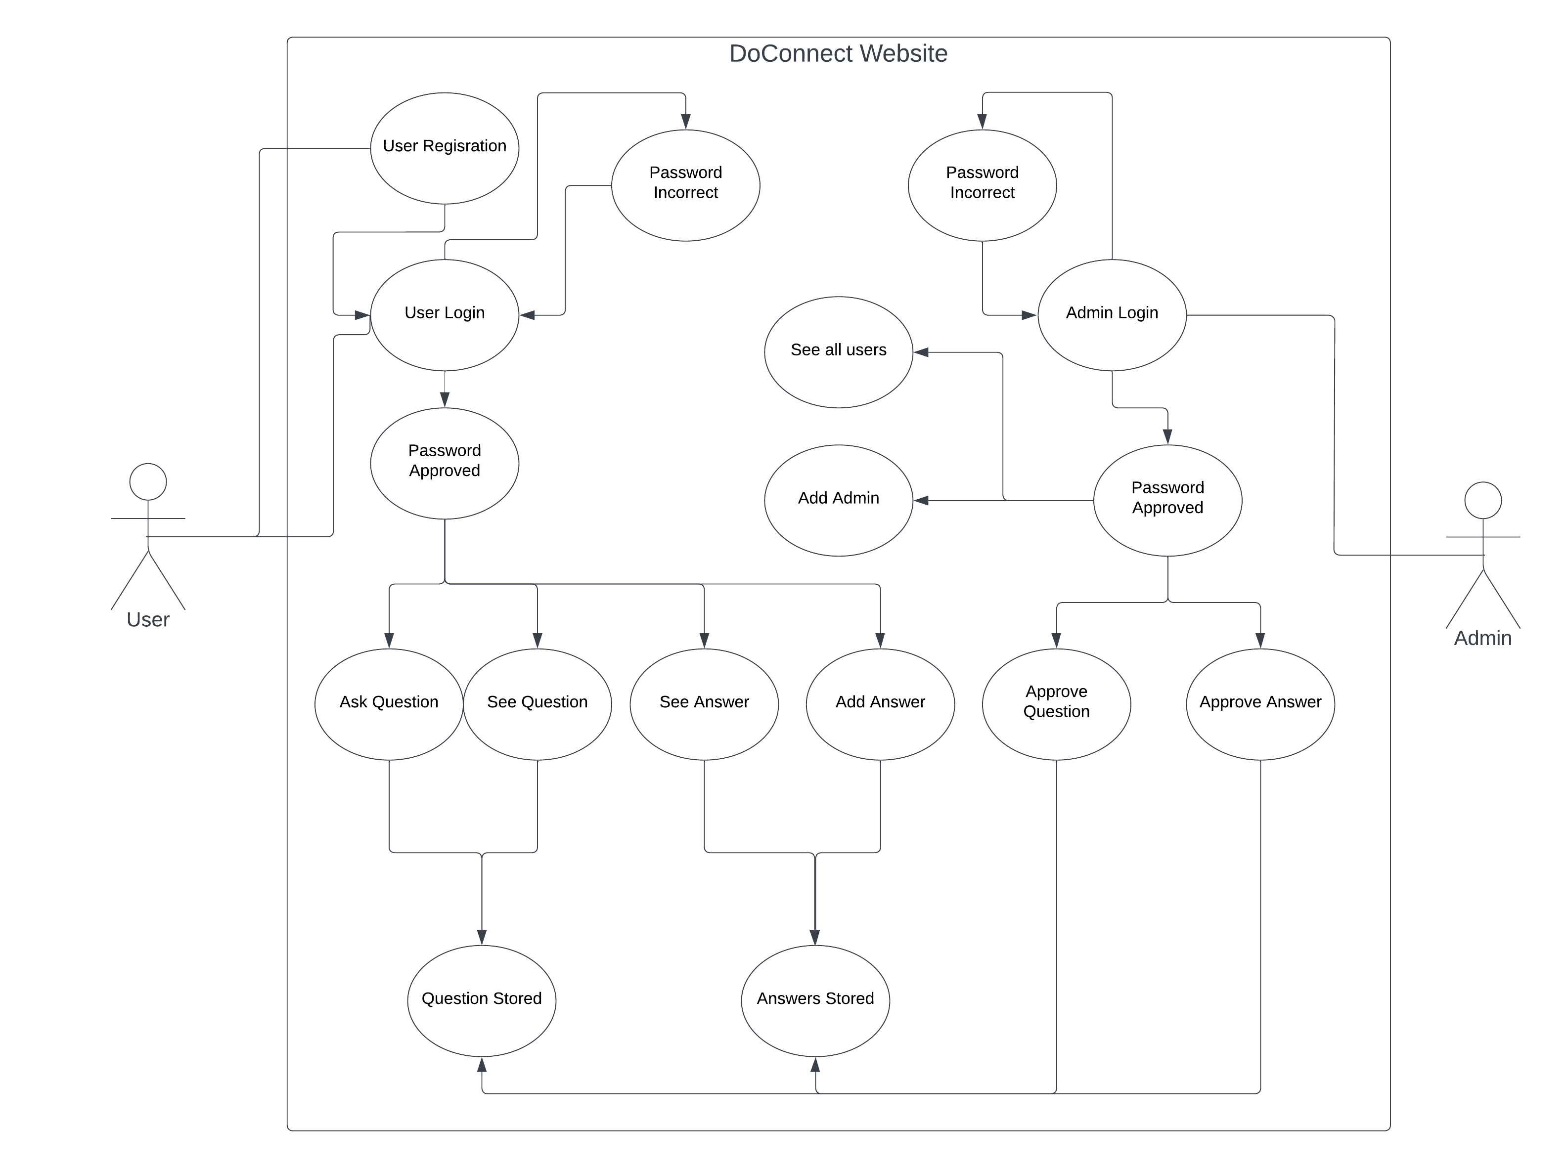
Use case diagram

Slide 10
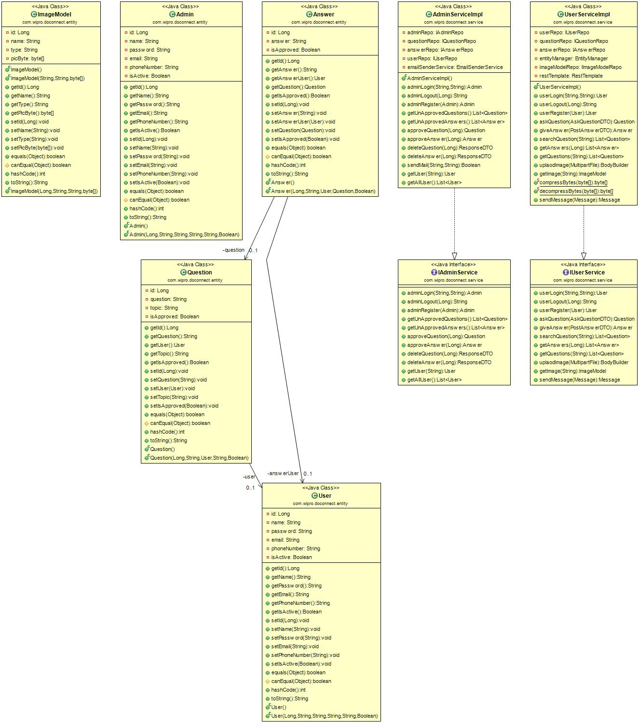
Class diagram

Slide 11
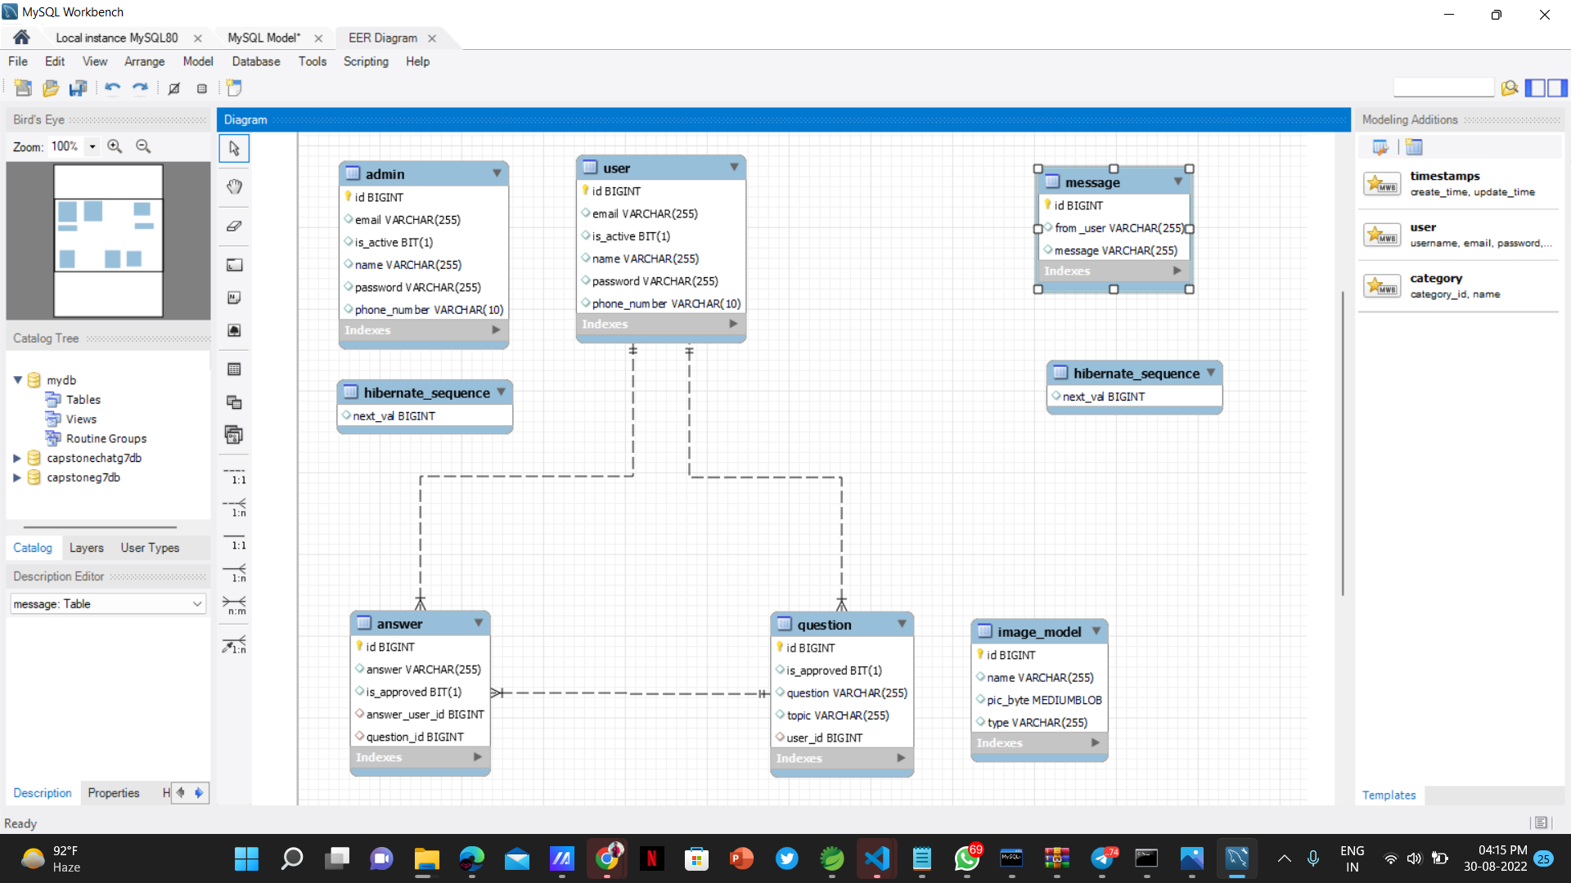
Er-diagram

Slide 12
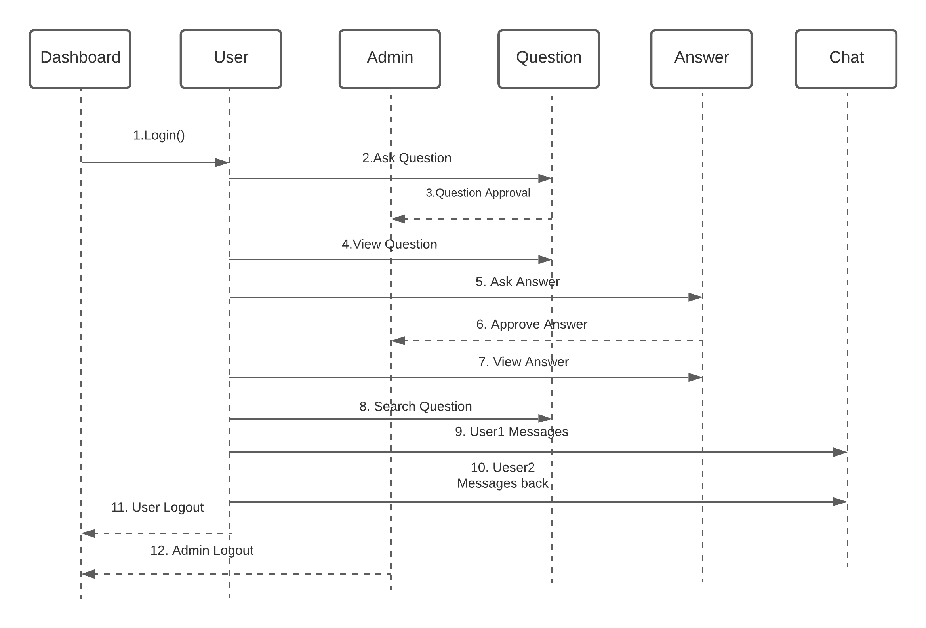
Sequence diagram

Slide 13
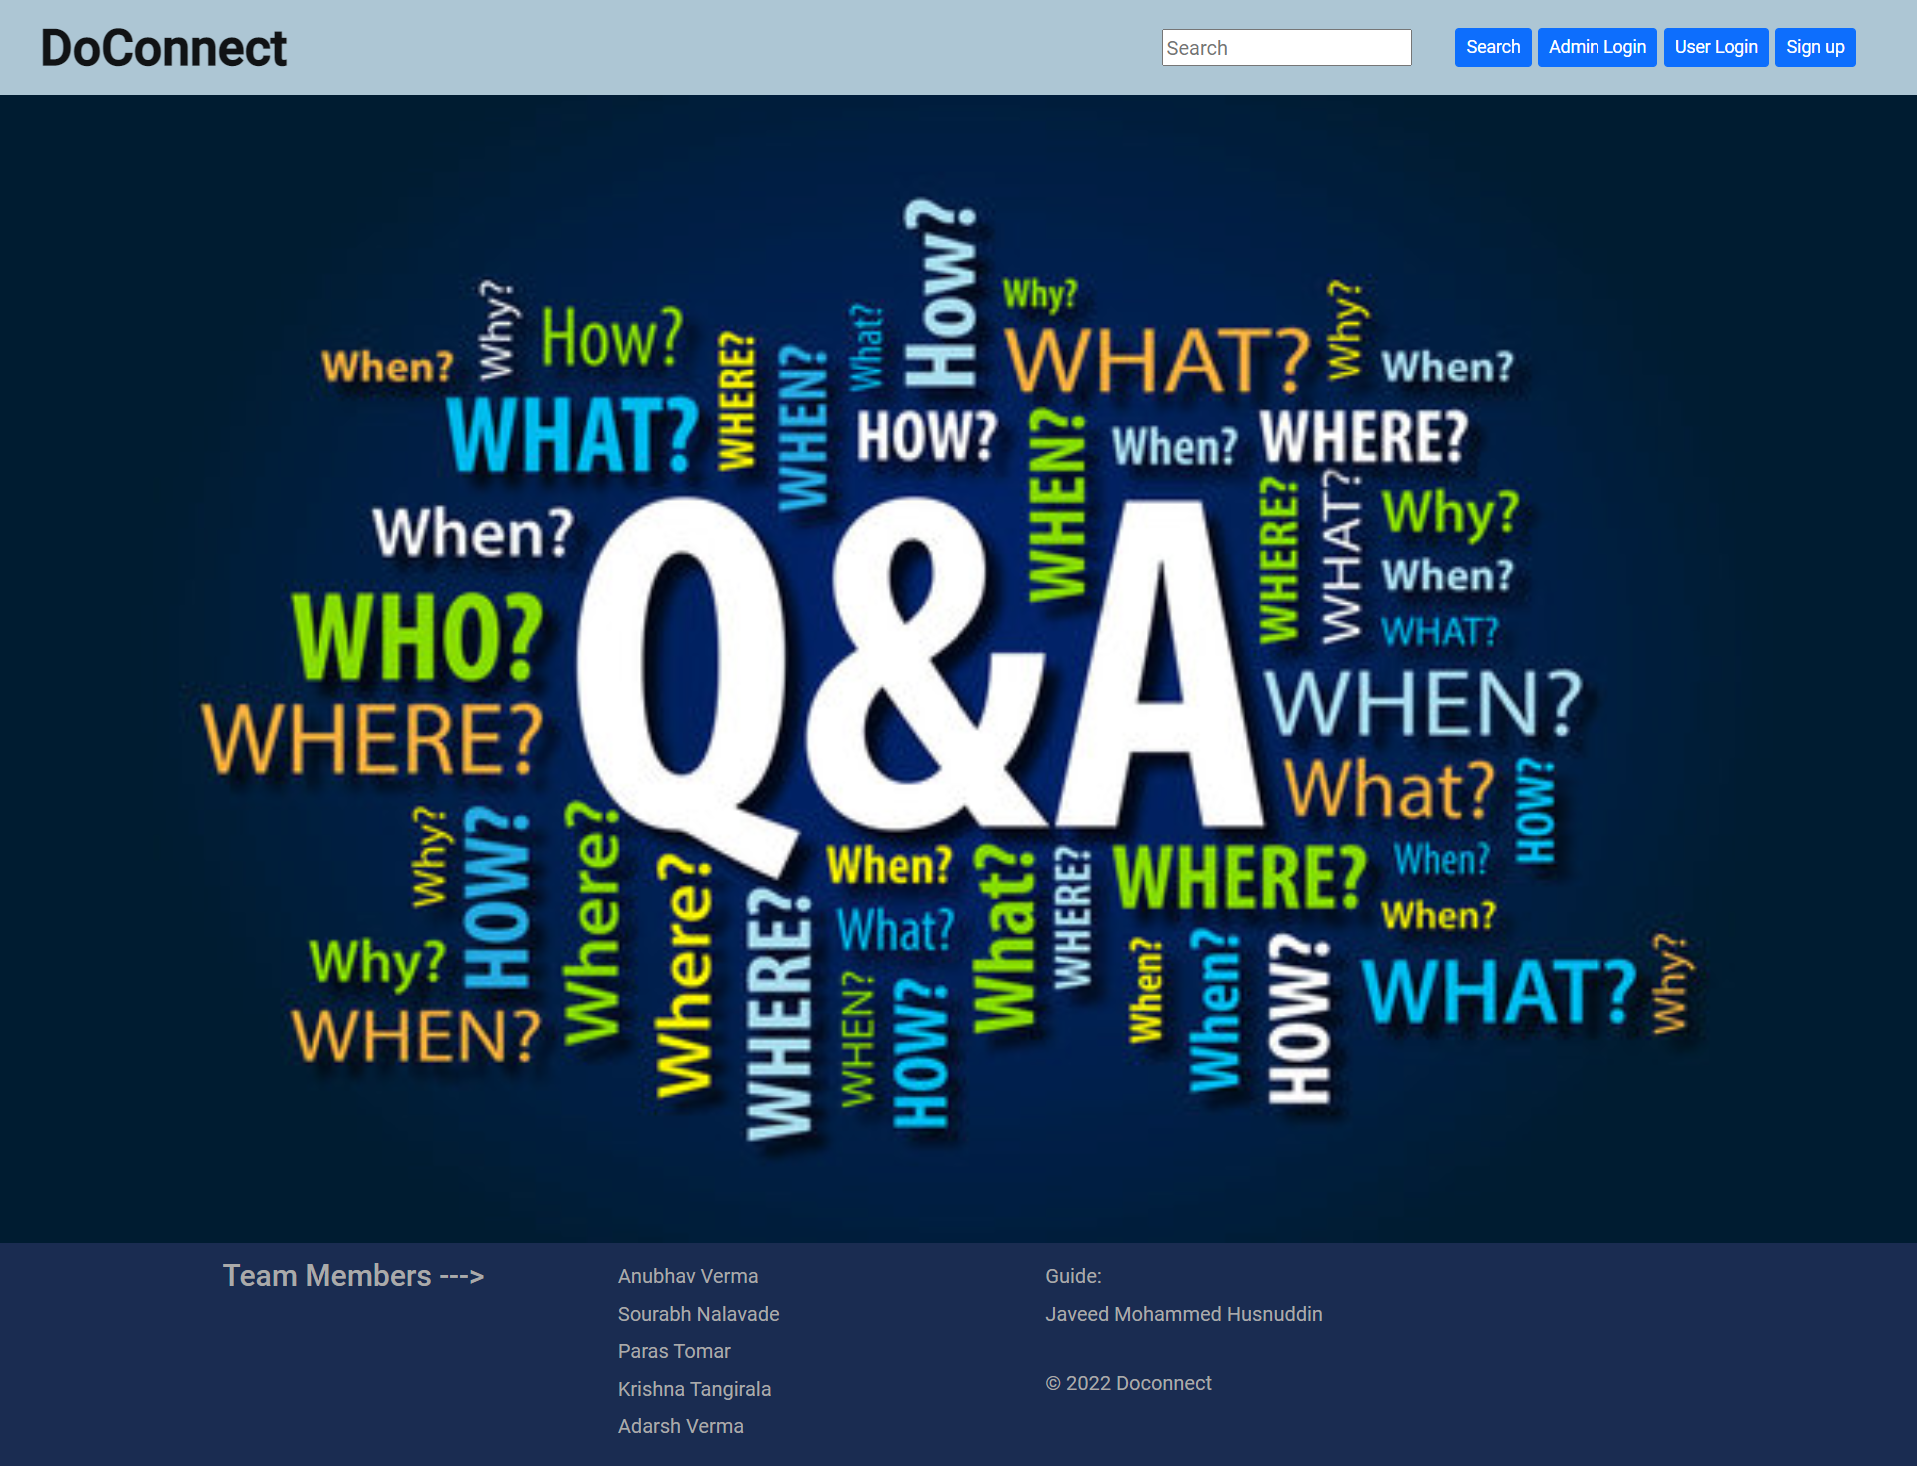
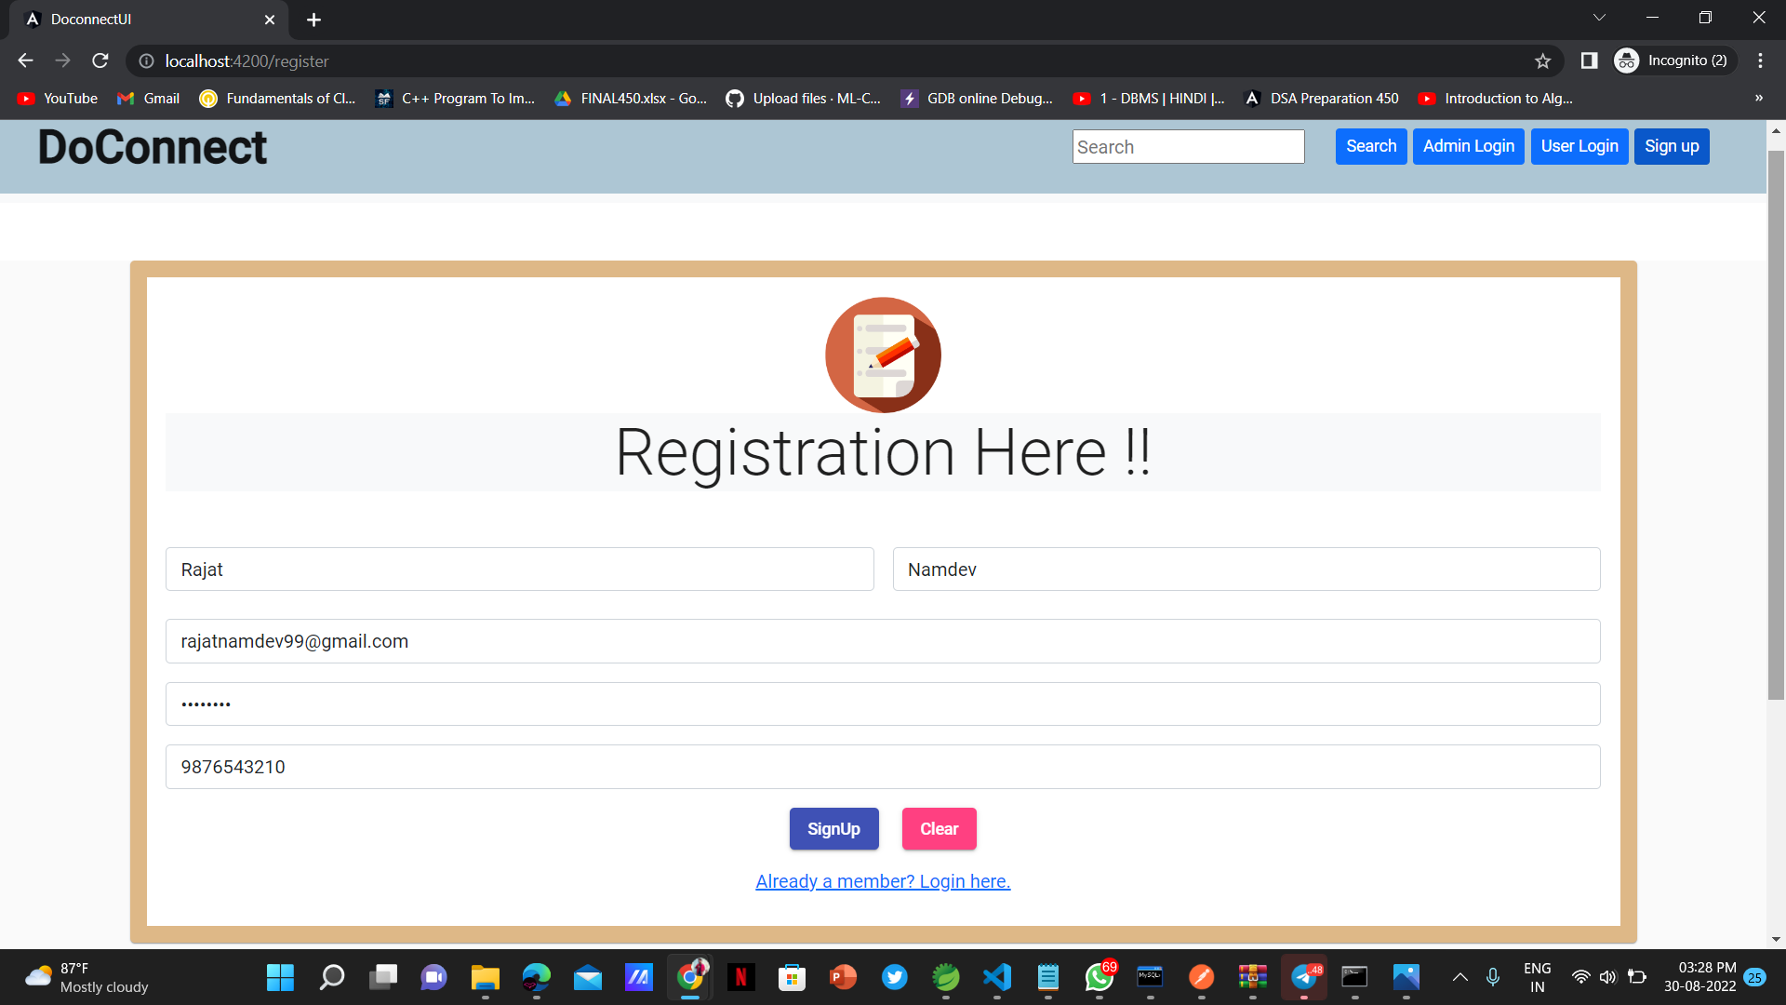
Screenshots

Slide 14
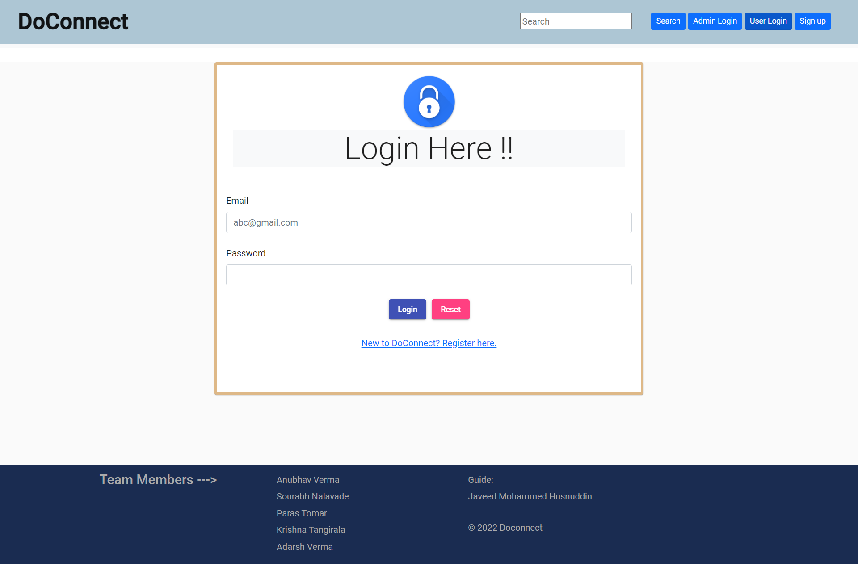
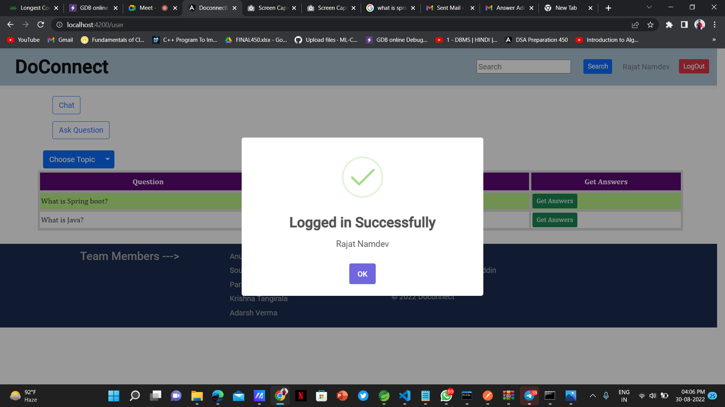
Screenshots

Slide 15
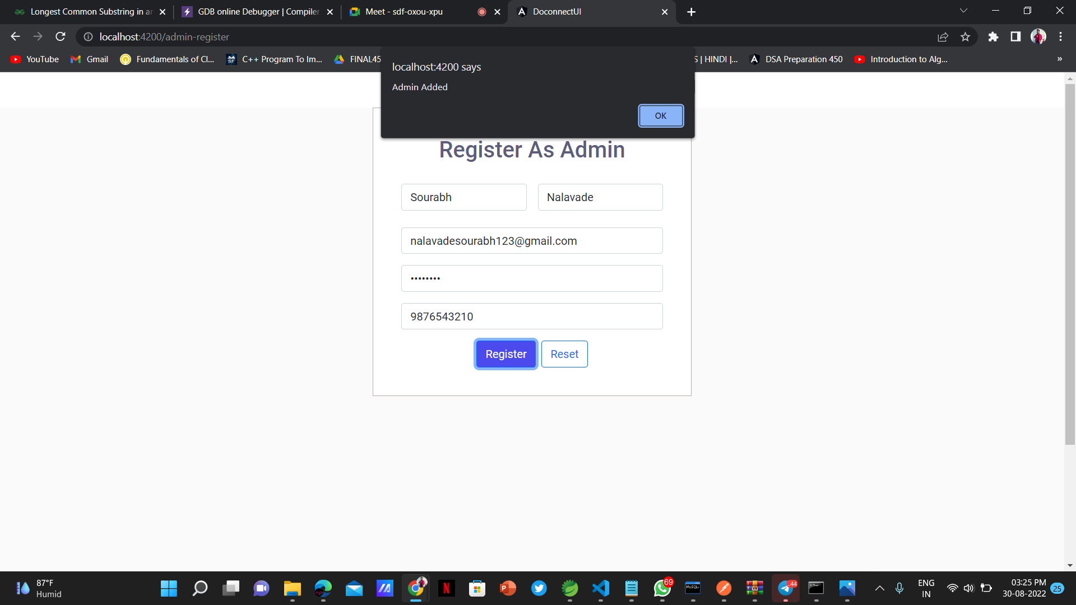
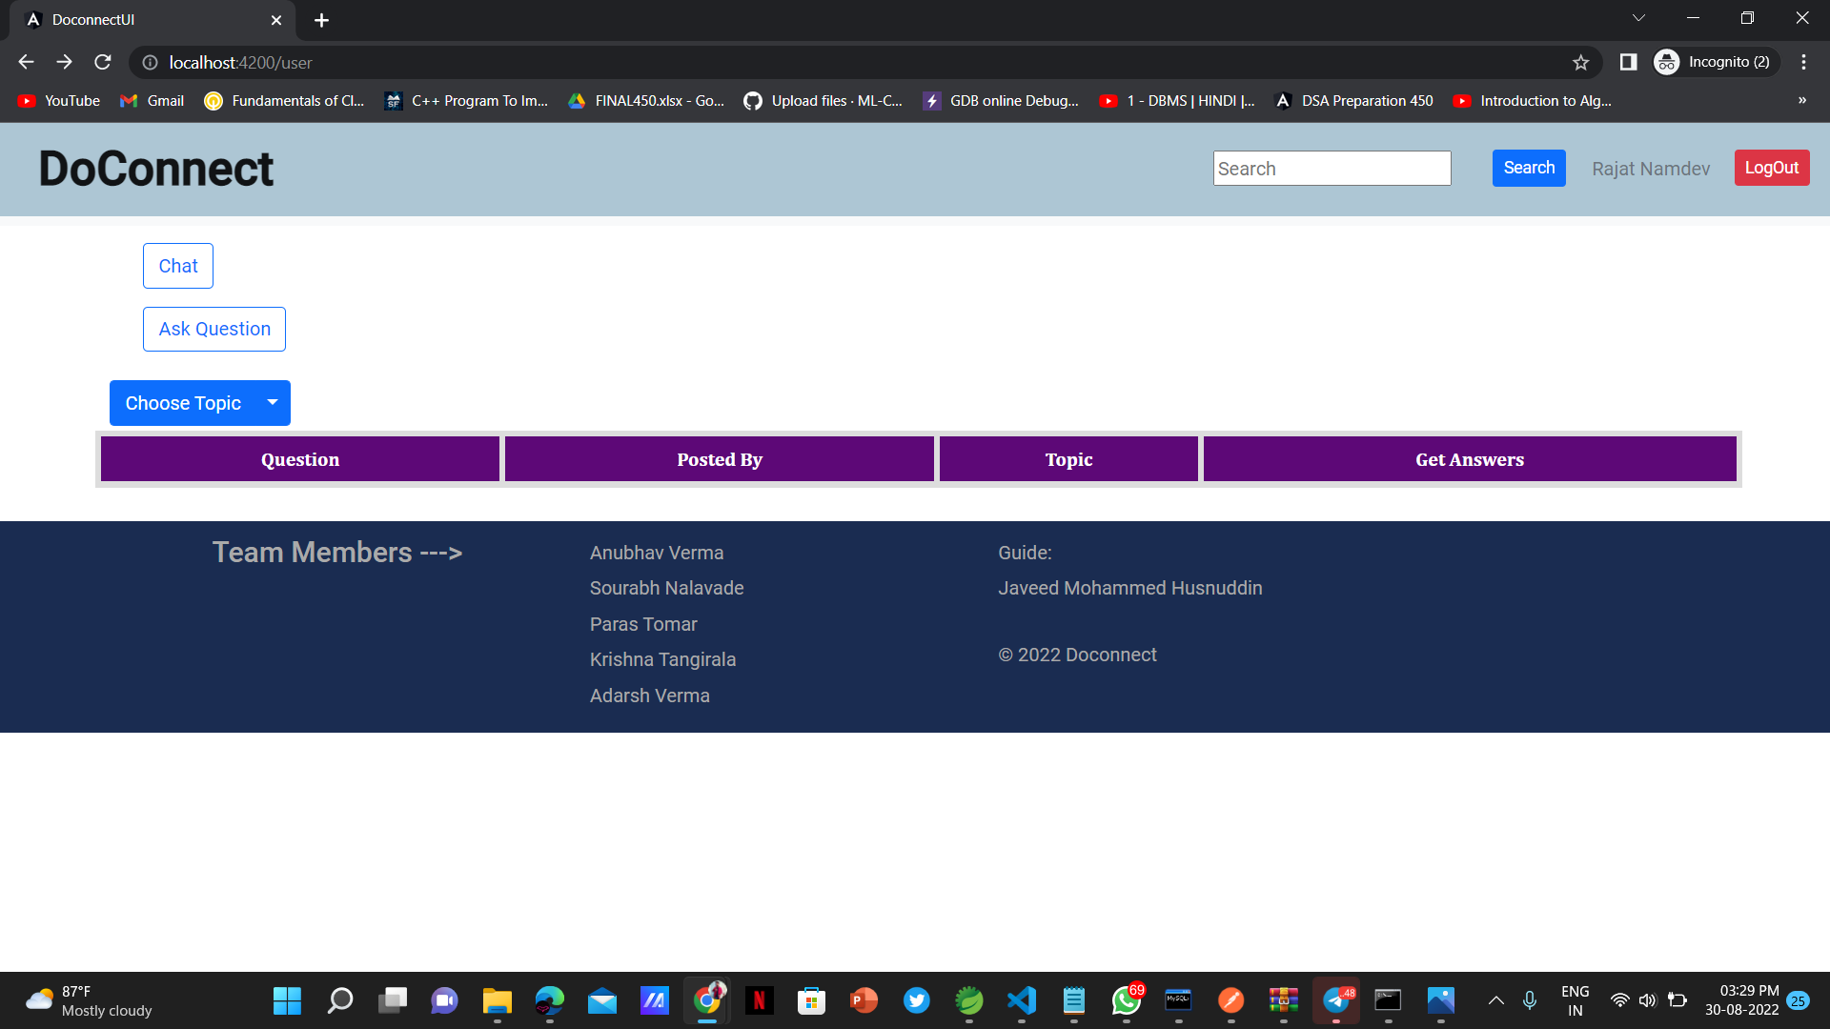
Screenshots

Slide 16
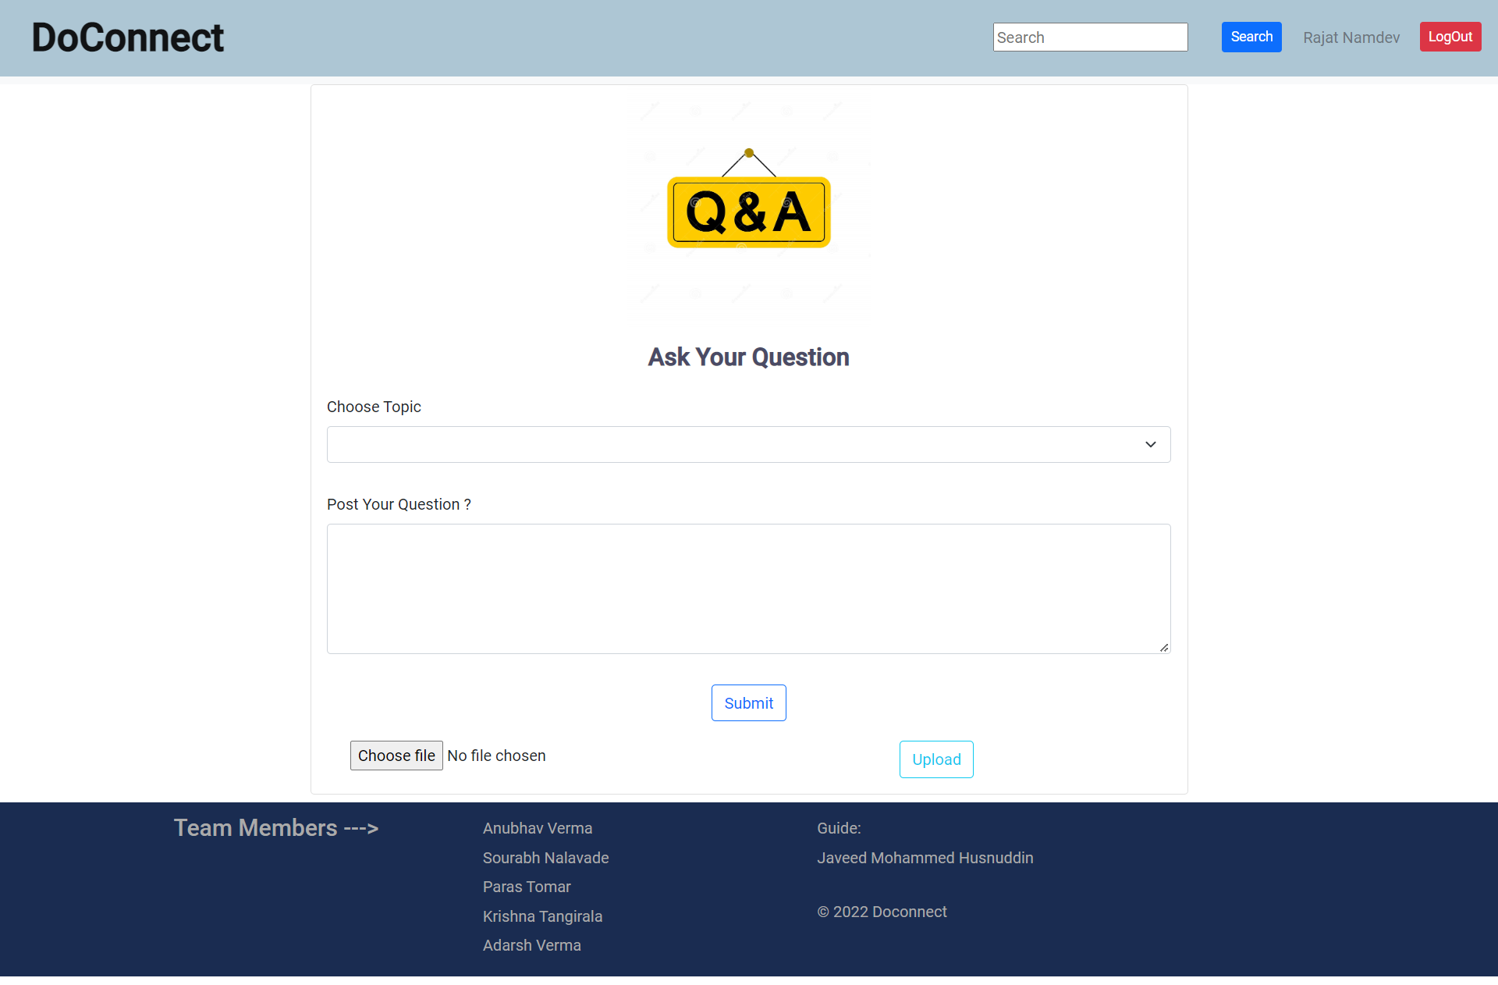
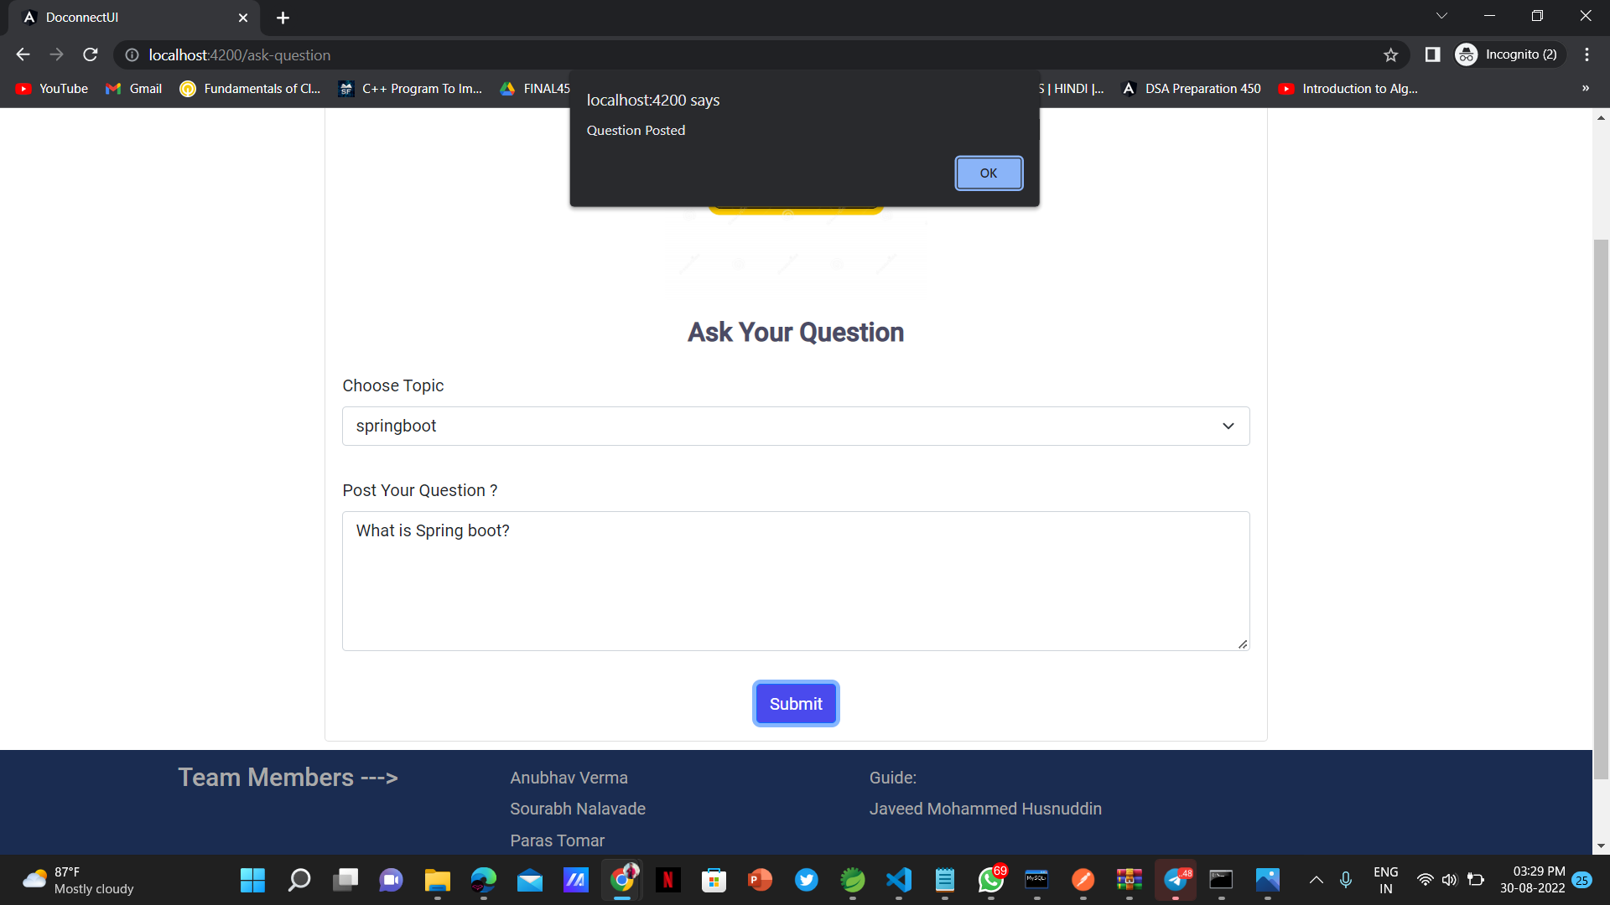
Screenshots

Slide 17
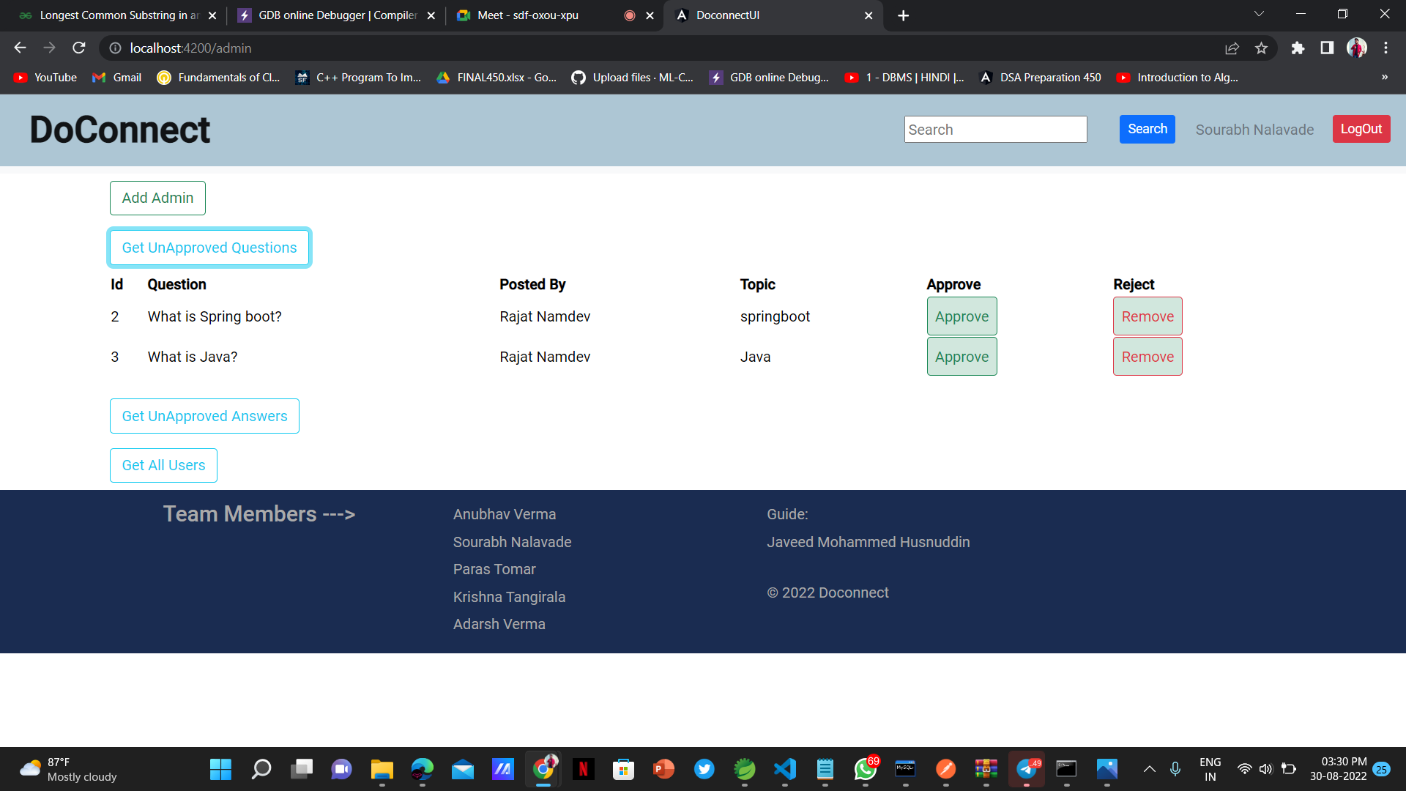
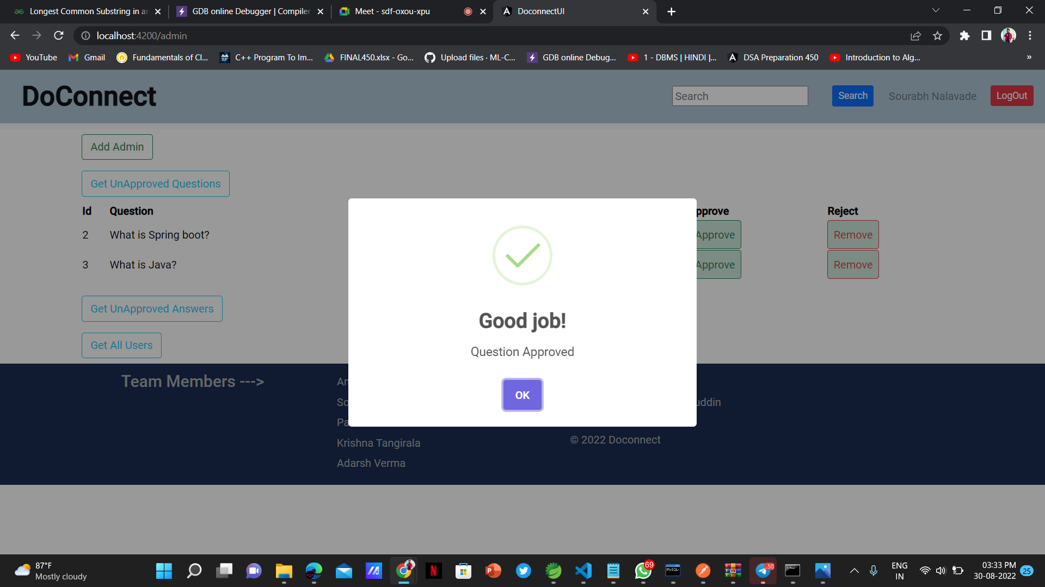
Screenshots

Slide 18
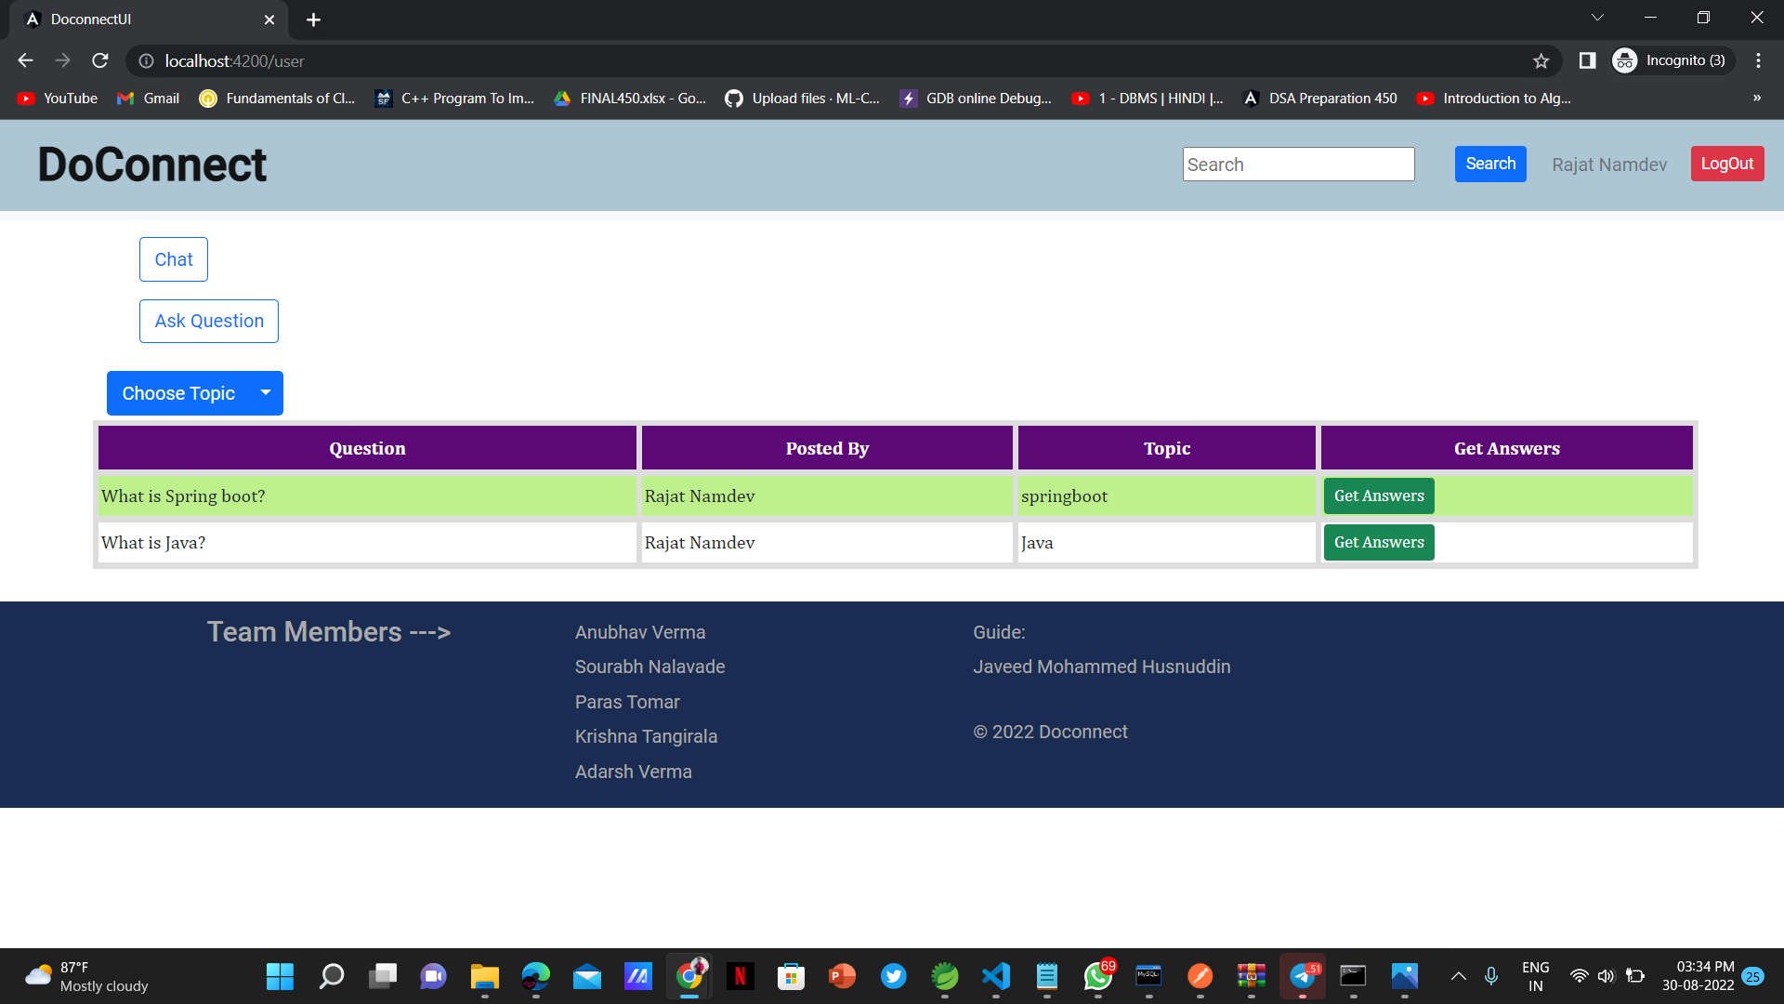
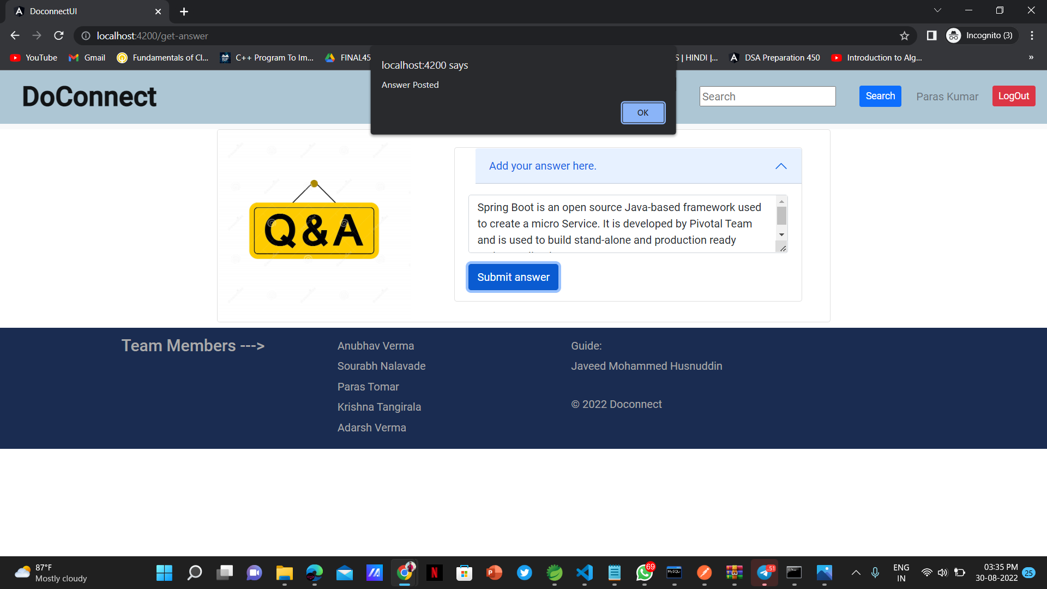
Screenshots

Slide 19
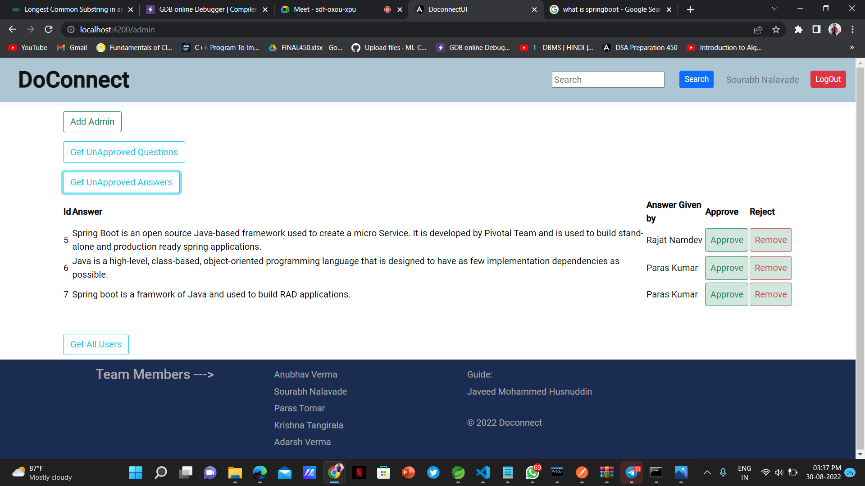
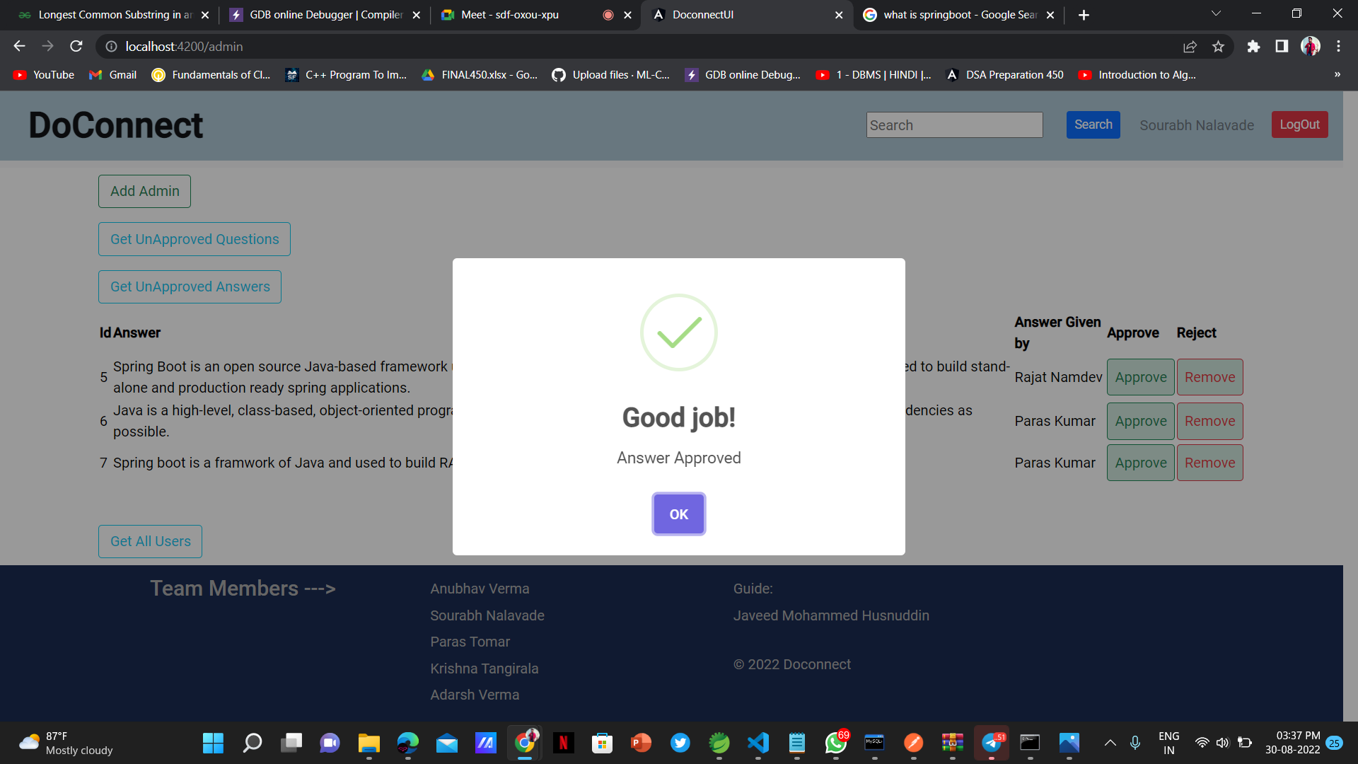
Screenshots

Slide 20
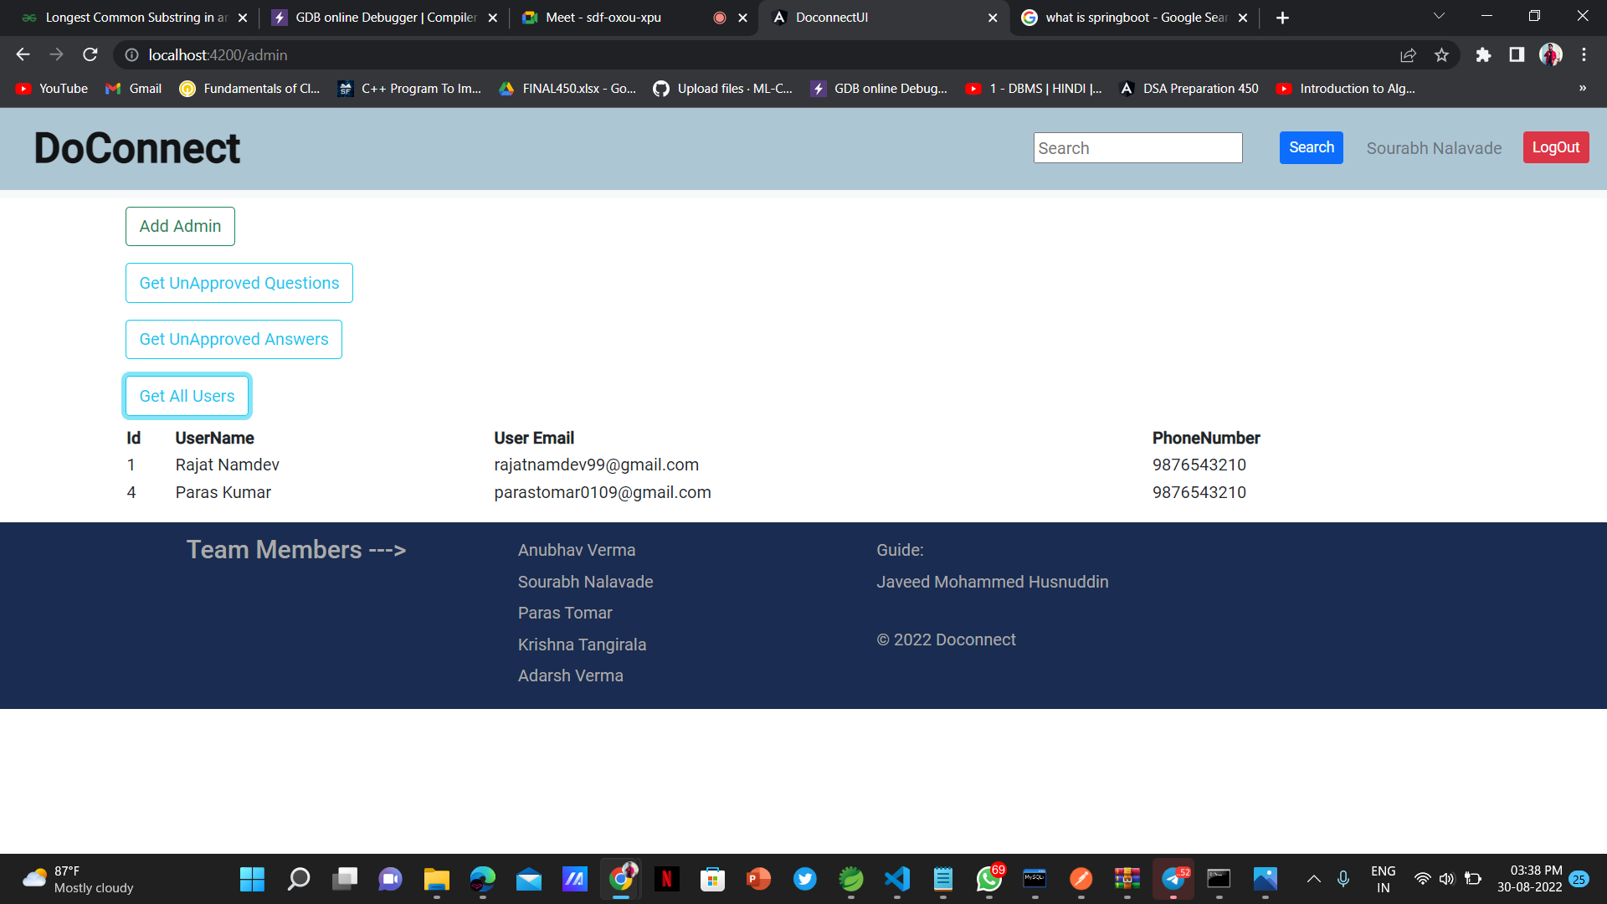
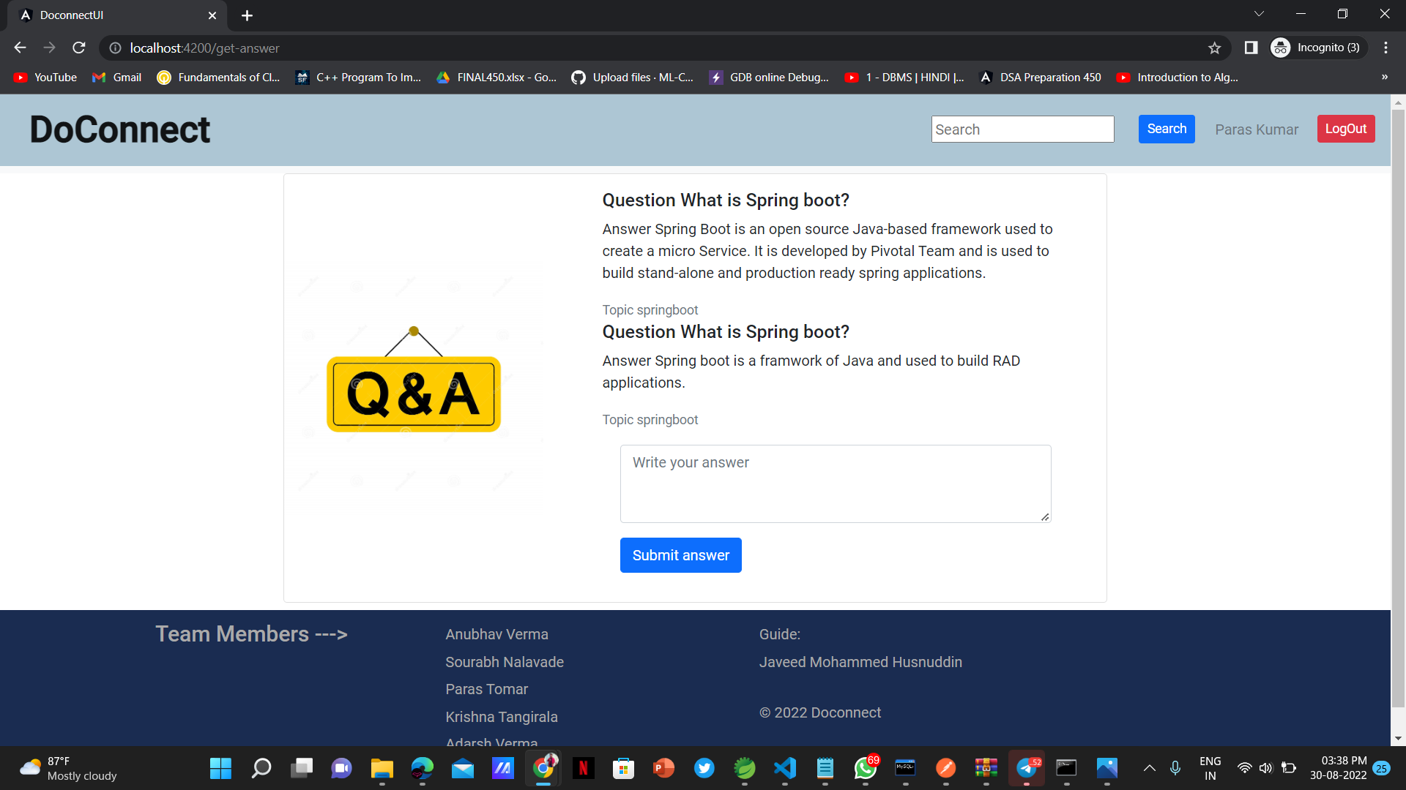
Screenshots

Slide 21
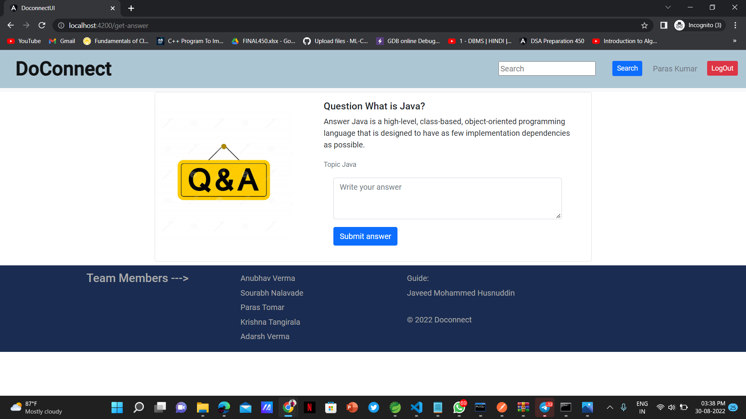
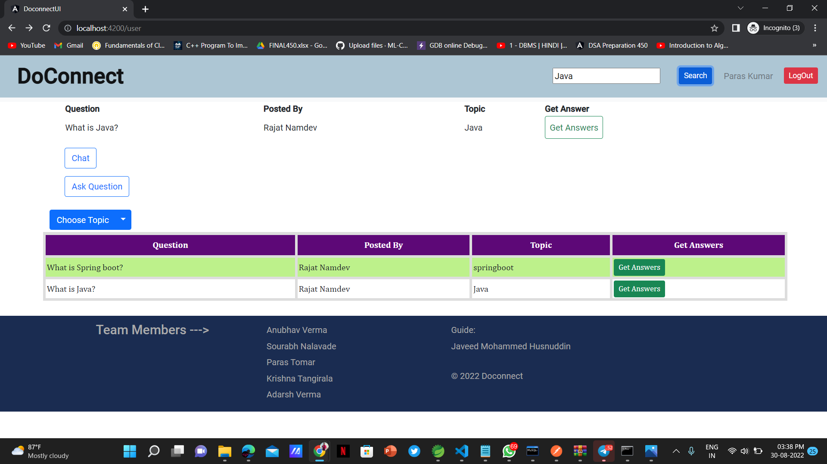
Screenshots

Slide 22
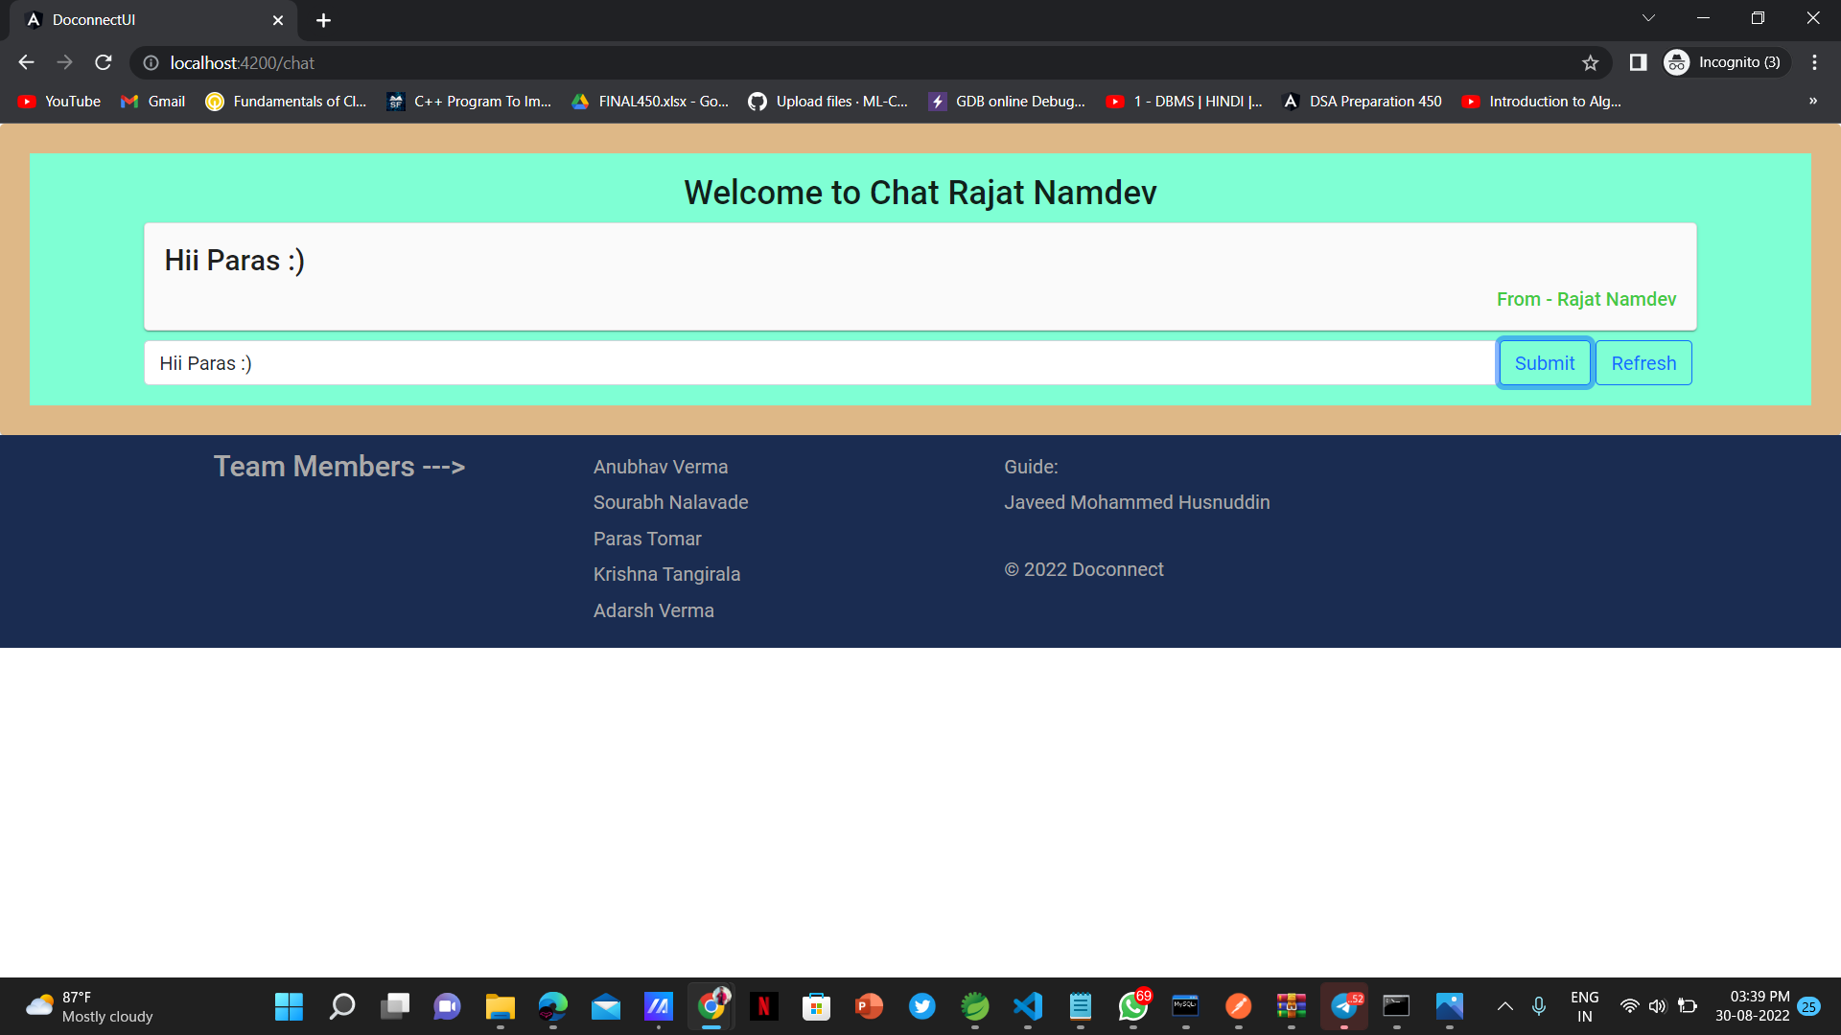
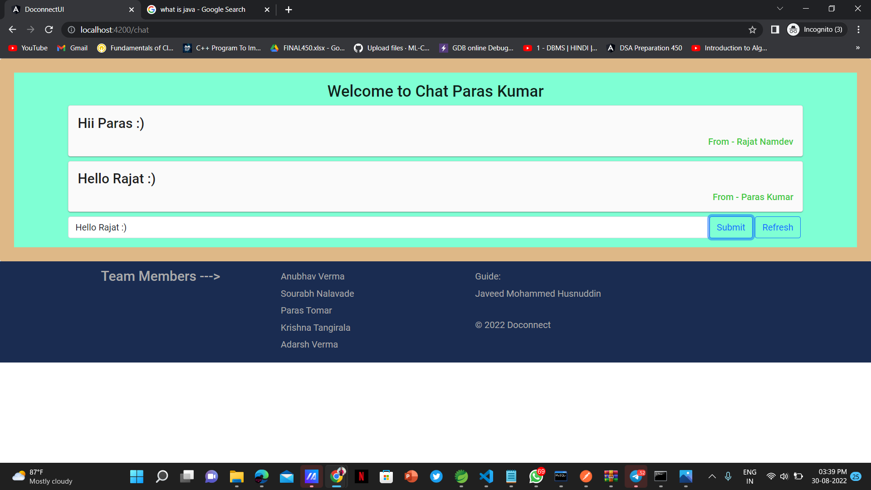
Screenshots

Slide 23
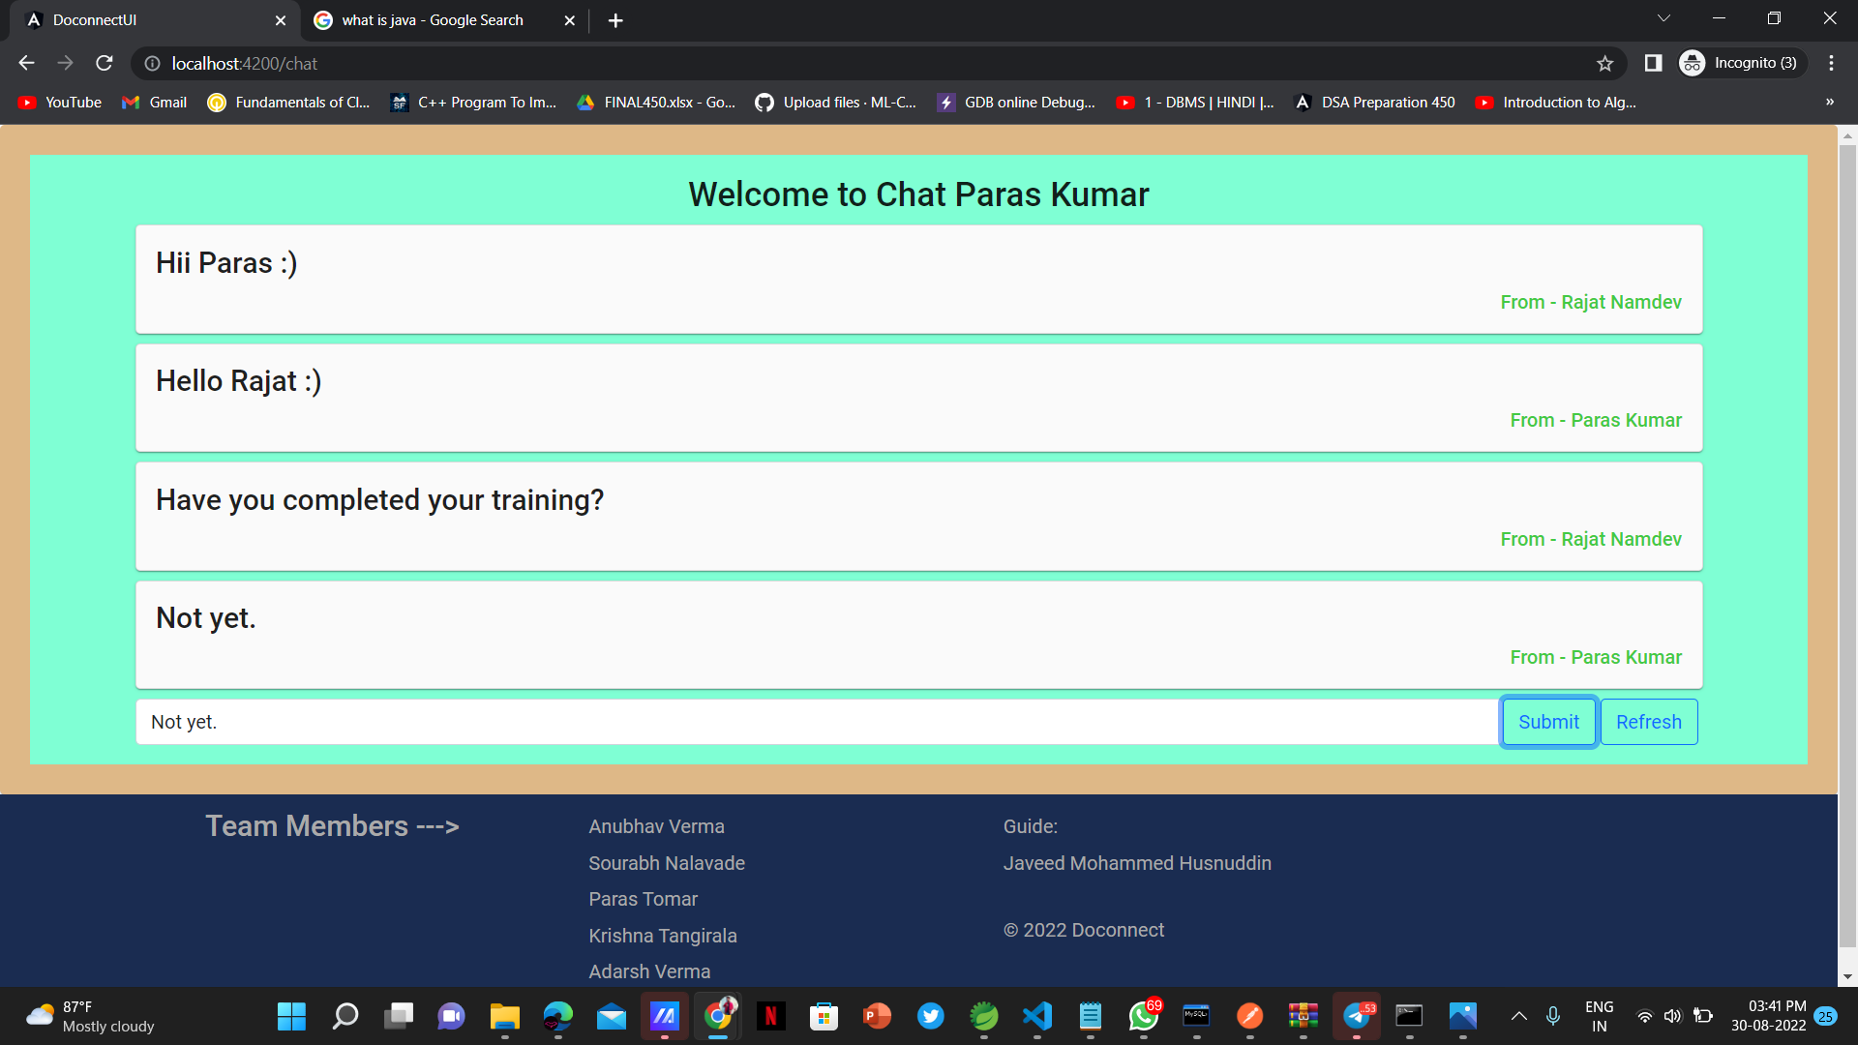
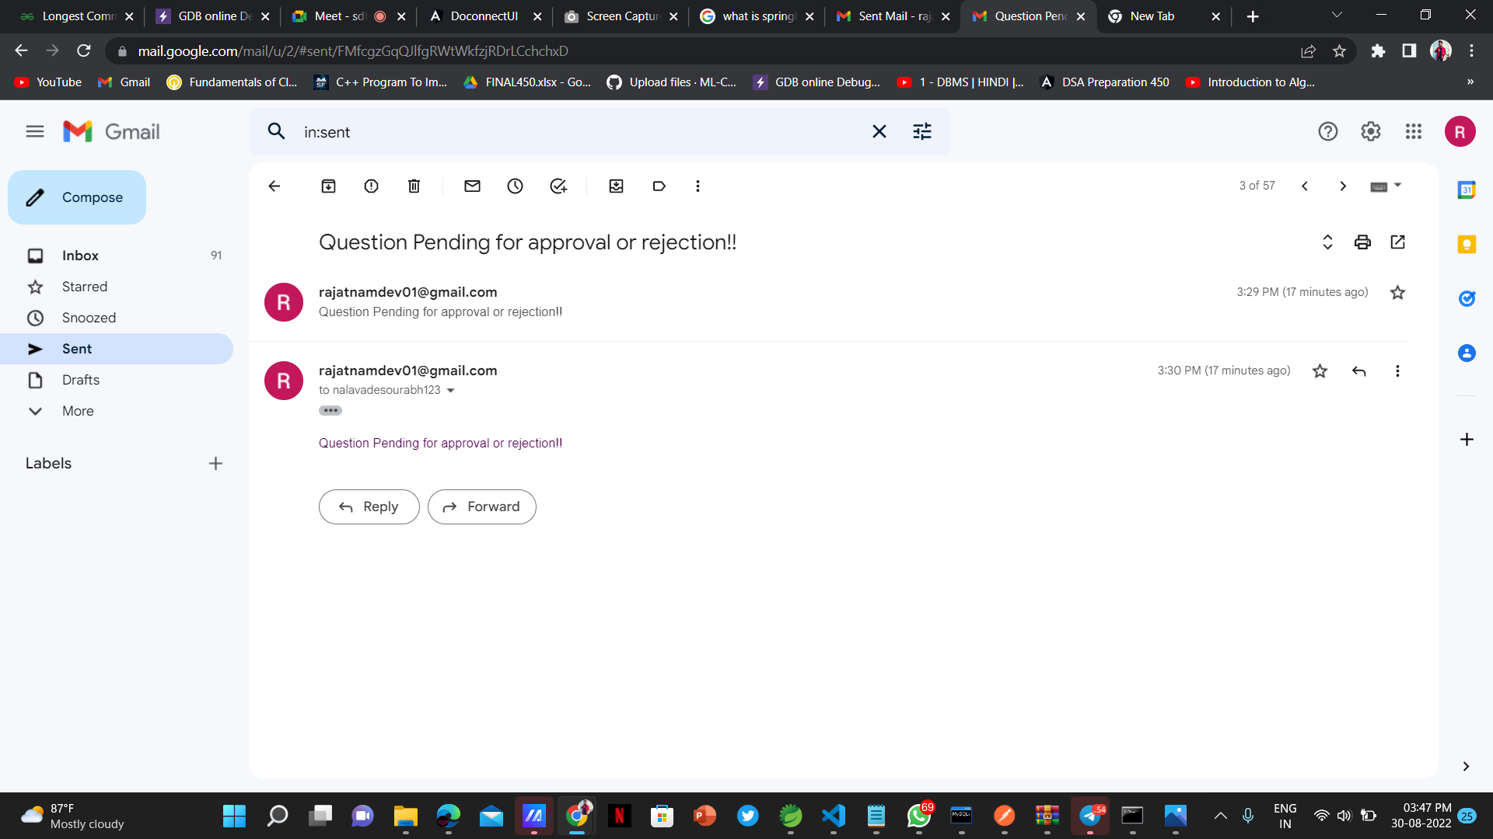
Screenshots

Slide 24
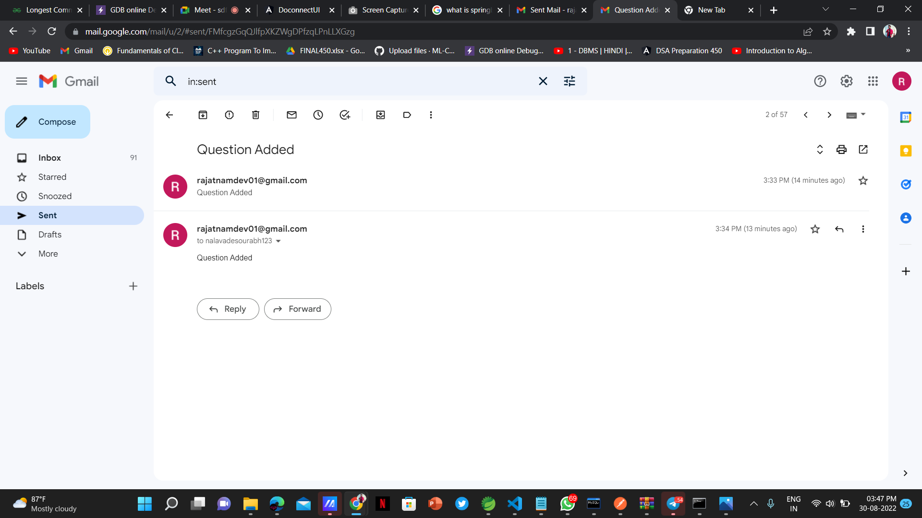
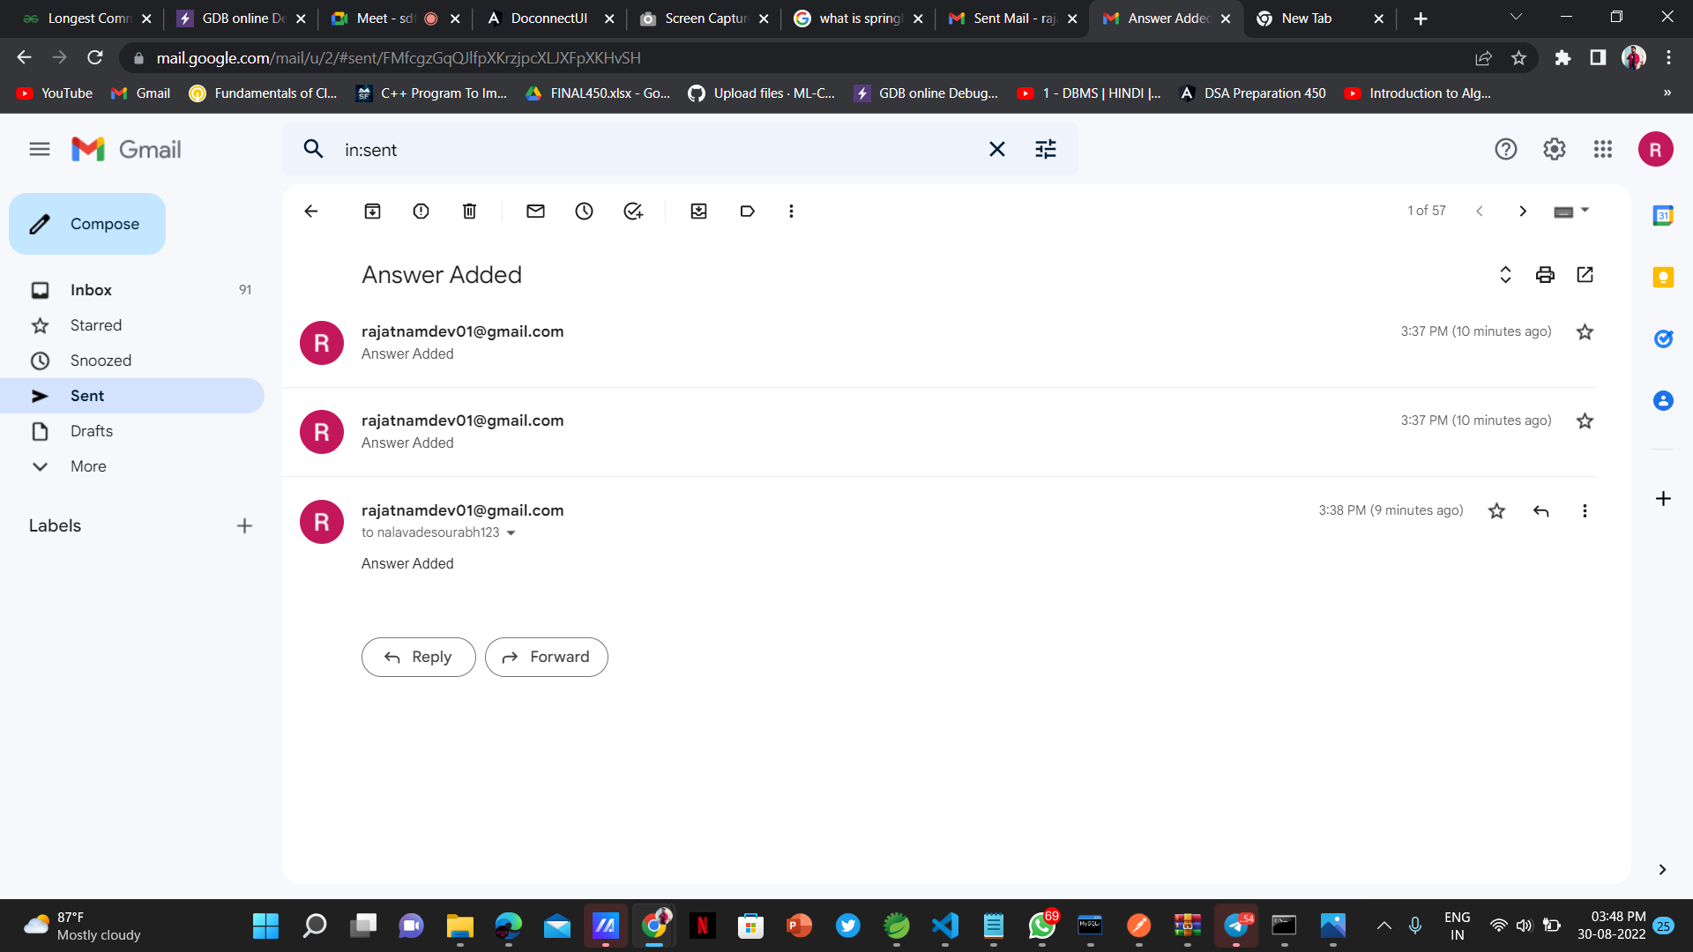
Screenshots

Slide 25
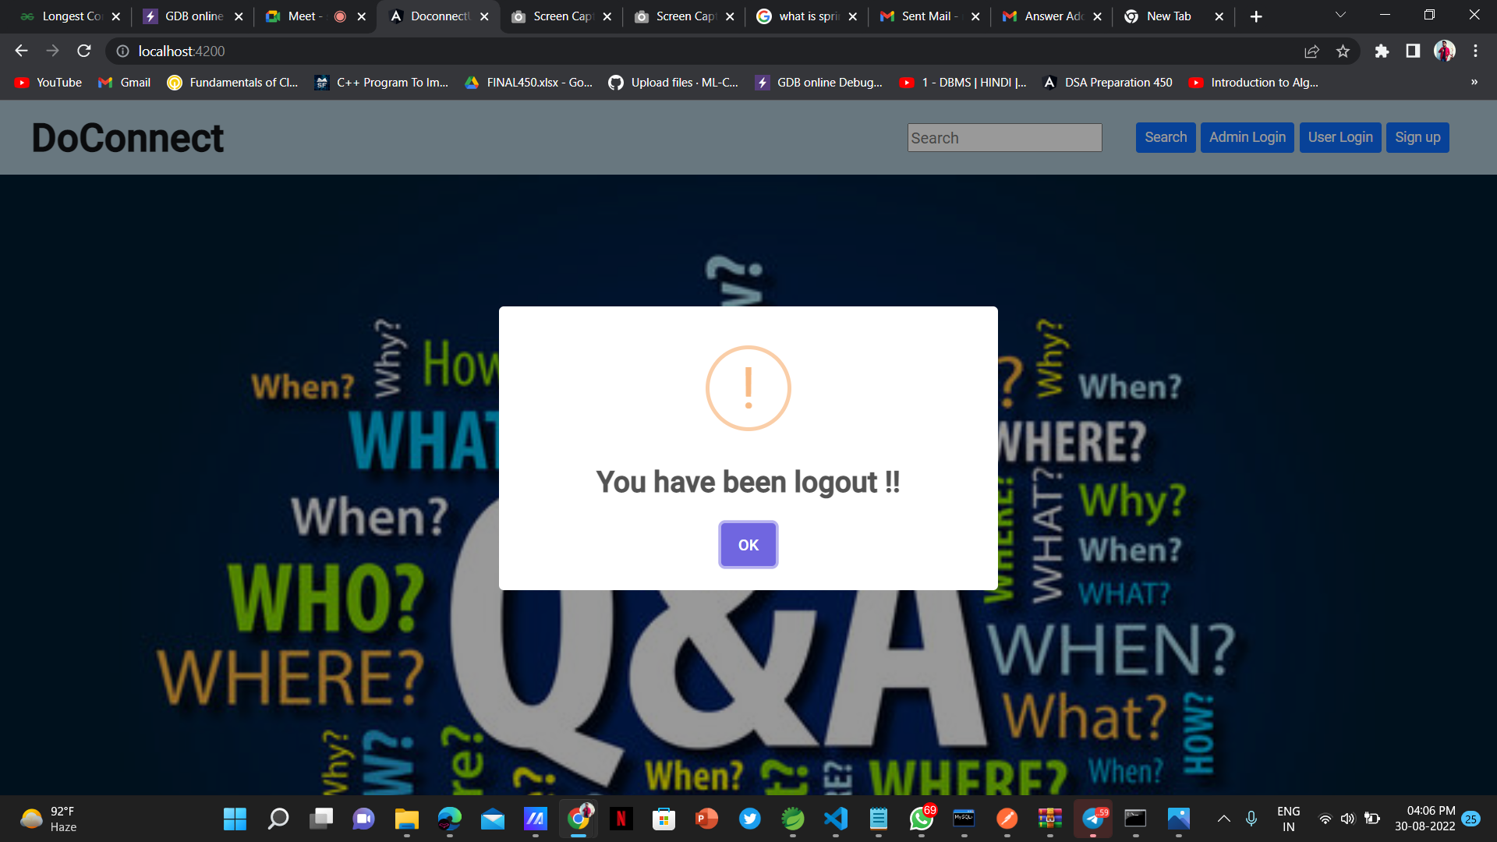
Screenshots

Slide 26

Thank
you

